Slide 1

Business Intelligence Mini Project
ITL602 BI LAB Semester VI
AY : 2021-2022
Data Set Name
Amphibians
Submitted By
Aashay Ingale 21104009
Student 2 Moodle ID
Student 3 Moodle ID

Slide 2
1. Problem Definition
Will Construction of Motorway harm the nearby Amphibians?

Slide 3
2. Dataset identified
Dataset Name: Amphibians
Dataset source: https://archive.ics.uci.edu/dataset/528/amphibians
Brief description of data:
- Objective: Predict presence of amphibian species near water reservoirs
- Data Sources: GIS systems, satellite images, field studies
- Road A Survey:
- Conducted 2010-2011, 2014-2016
- 80 locations identified for amphibians
- Road B Survey:
- Explored two route options
- Identified 125 amphibian locations
- 109 spots identified within 500m of road paths
- Importance: Understanding impact of motorway projects on amphibian habitats

Slide 4
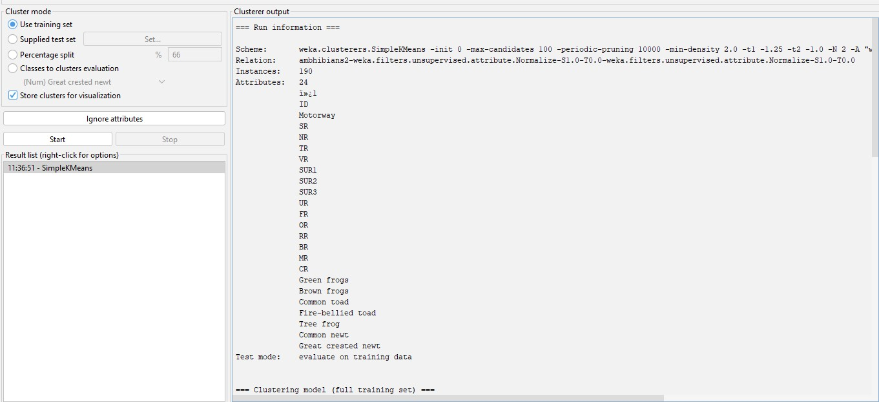
3. Data mining task performed
Clustering :
a. SimplekMeans

Slide 5
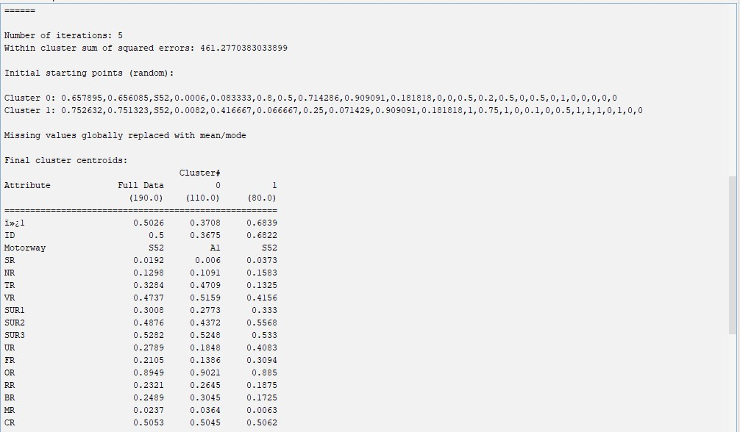

Slide 6
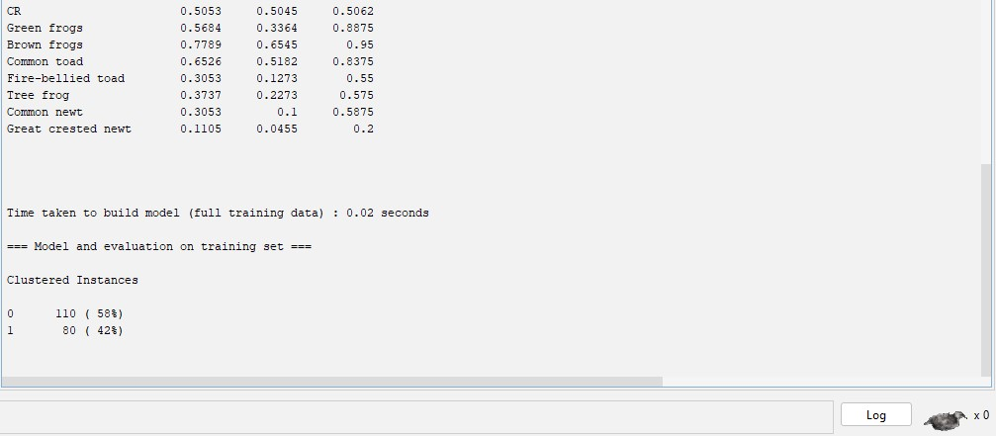

Slide 7
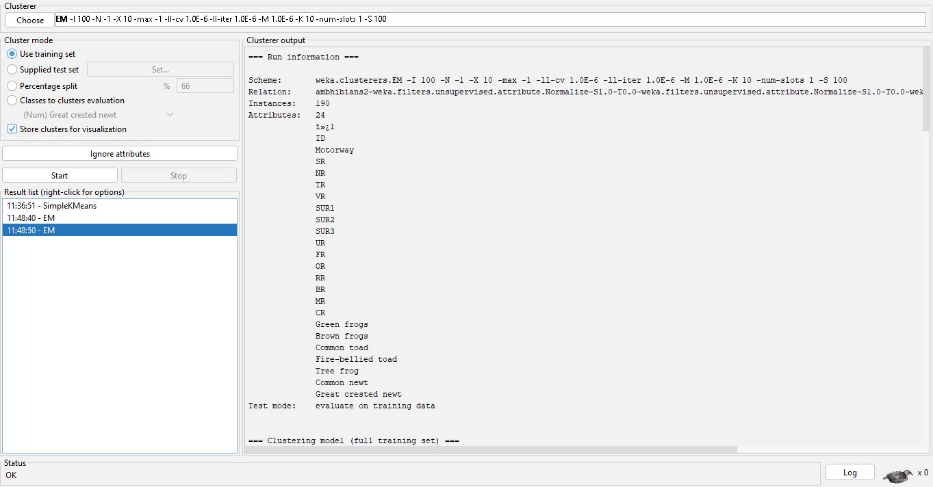
b. EM

Slide 8
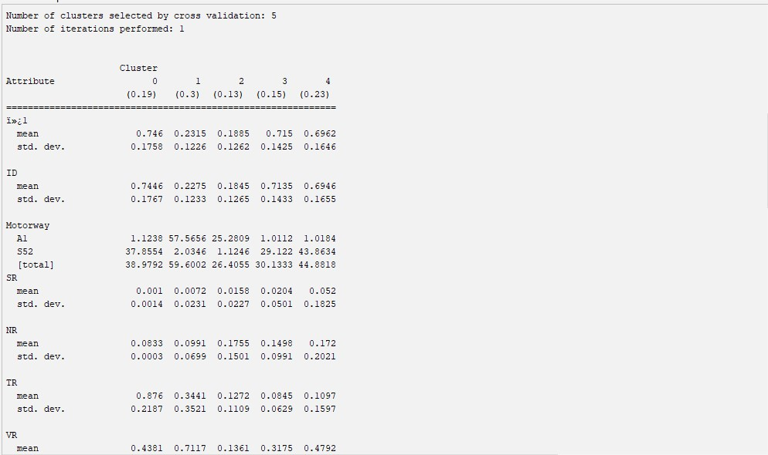

Slide 9
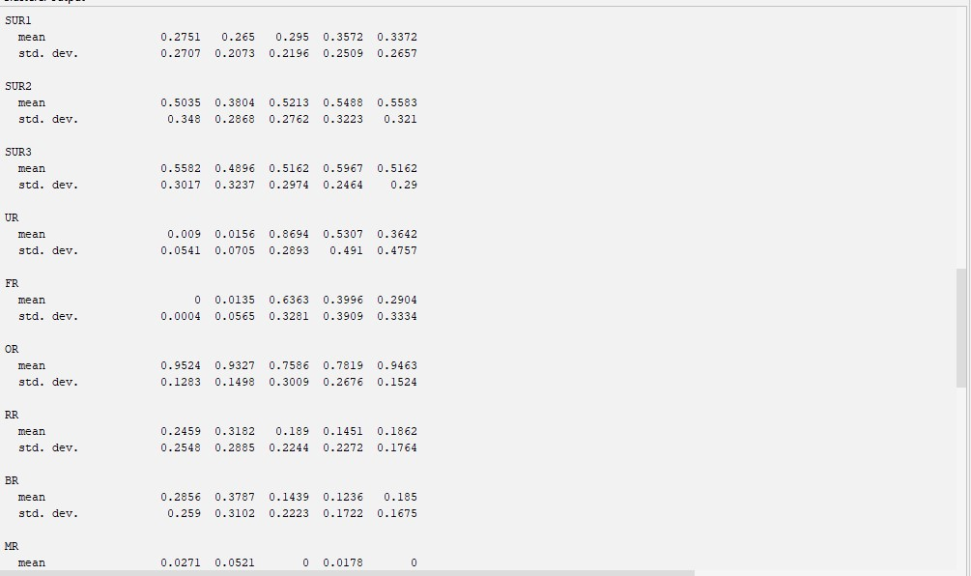

Slide 10
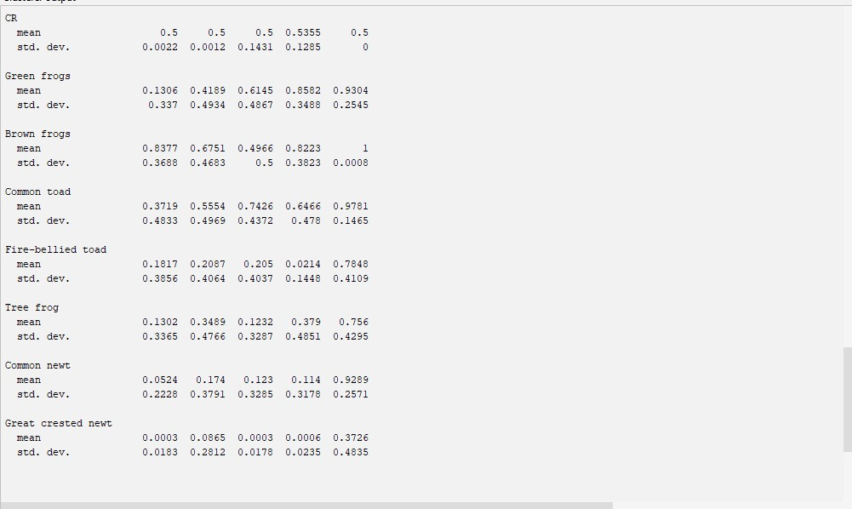

Slide 11
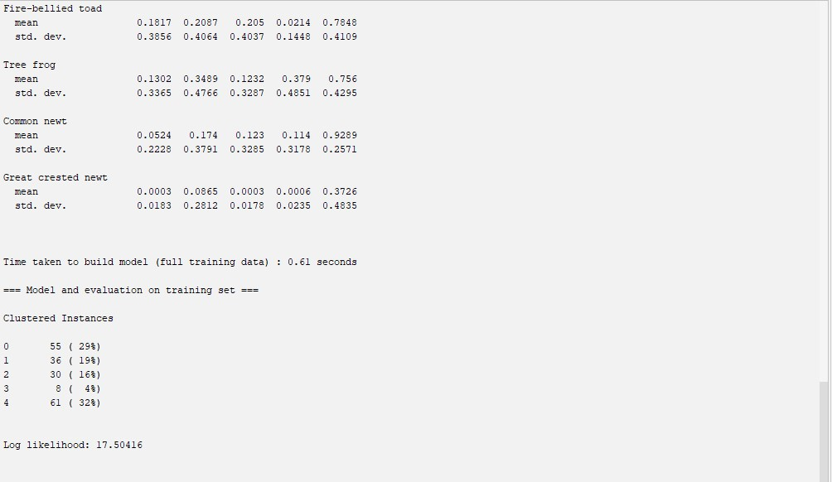

Slide 12
4. Conclusion
Determining the "best" algorithm between Simple K Means and EM (Expectation-Maximization) for a specific dataset depends on various factors such as the dataset's characteristics, the nature of the problem, and the goals of the analysis.
1. Nature of the Data:
- Simple K Means: Assumes spherical clusters and works well with compact, well-separated clusters.
- EM: Assumes Gaussian distributions and is effective for data with overlapping clusters or clusters of different shapes.
2. Cluster Shape and Size:
- Simple K Means: Works best when clusters are well-separated and have similar sizes.
- EM: Can handle clusters with different shapes and sizes, as it models clusters using Gaussian distributions.
3. Robustness to Outliers:
- Simple K Means: Sensitive to outliers, as it assigns each point to the nearest cluster centroid.
- EM: Less sensitive to outliers due to its probabilistic approach, where points contribute to cluster assignments based on probabilities.

Slide 13
4. Scalability:
- Simple K Means: Generally more scalable and computationally efficient compared to EM, especially for large datasets.
- EM: Can be slower, especially for high-dimensional datasets, as it involves iterative estimation of Gaussian parameters.
5. Interpretability:
- Simple K Means: Cluster centroids provide interpretable means of clusters.
- EM: Provides probabilistic cluster assignments and model parameters, allowing for more detailed interpretation of cluster memberships.
Given the information provided and considering the characteristics of the dataset, if the clusters are well-separated and have similar sizes, Simple K Means might perform better. However, if the clusters have different shapes, sizes, or there are overlapping clusters, EM might yield better results. Additionally, if the dataset contains outliers or noise, EM could be more robust. Ultimately, it's advisable to experiment with both algorithms and evaluate their performance using appropriate metrics or through cross-validation.

